Slide 1
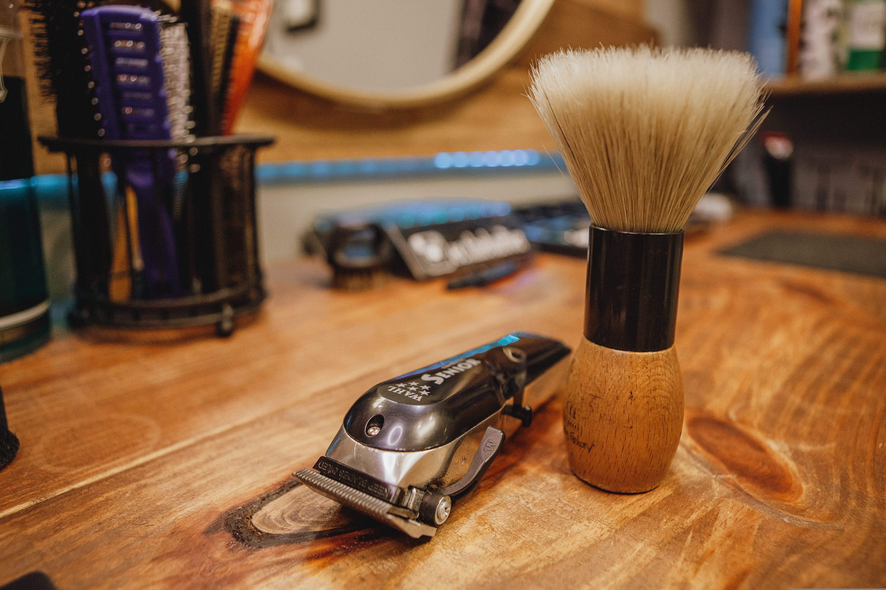
Web Design And Development
Midterm – Dr.Richard
TEAM AHHS
BARBER SHOP

Slide 2

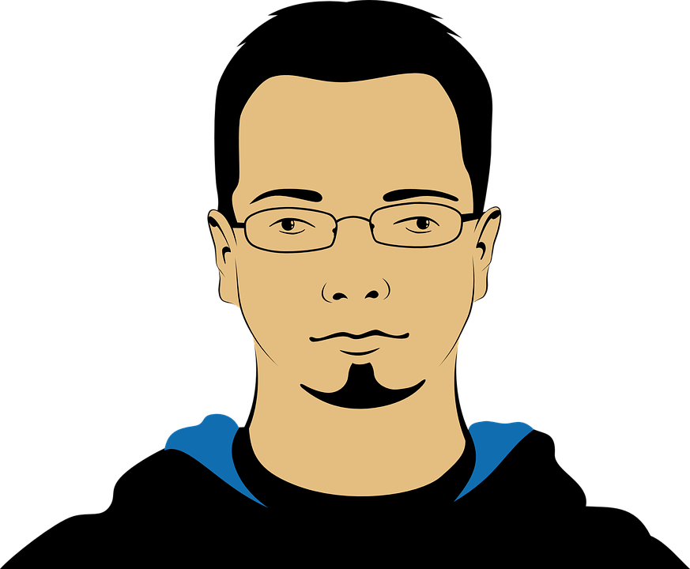
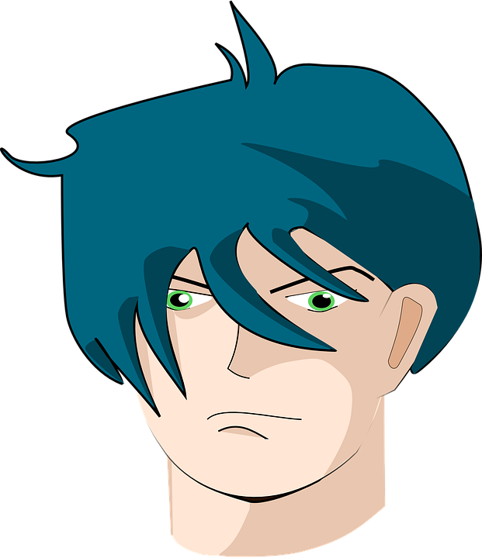


TEAM AHHS
HUY ANH
HUU HOC
VAN SI
HOANG HAI

Slide 3



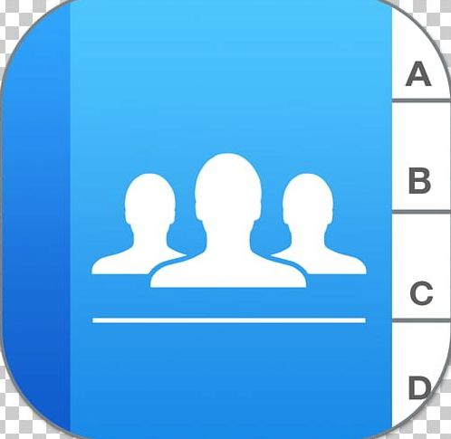
BARBER SHOP
Home
About
Contact

Slide 4
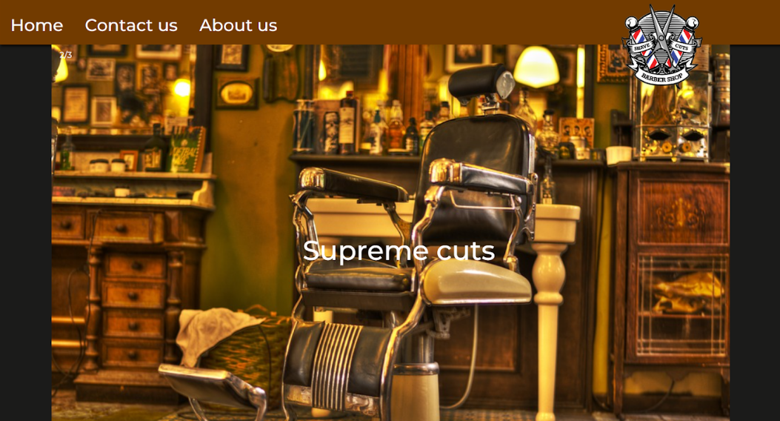
This is the homepage of our website, where you can find essential information about our store. From this home page, you can navigate to our About and Contact pages.

Slide 5
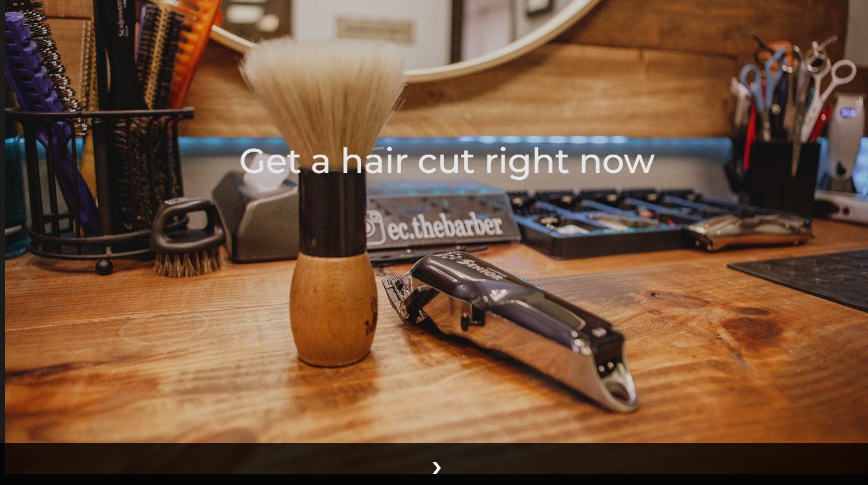
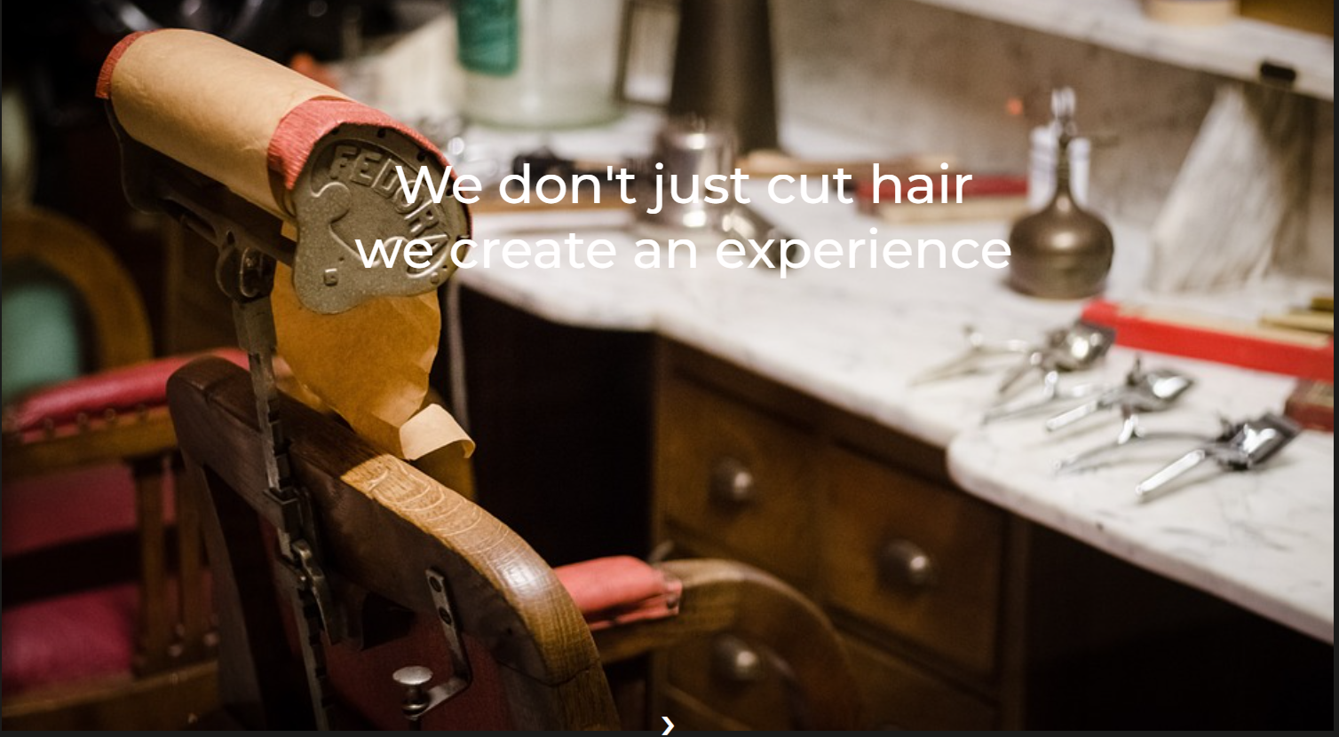
Furthermore, in the home page, we also have a slideshow to move image back and forth by click the move arrows. Fully display our professional workplace.

Slide 6
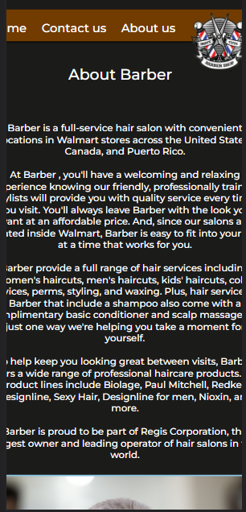
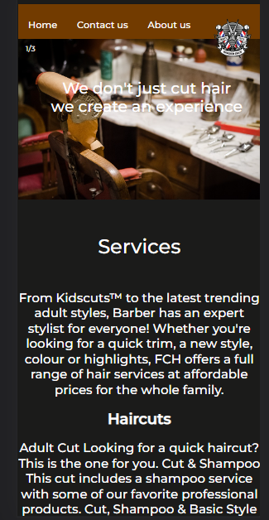
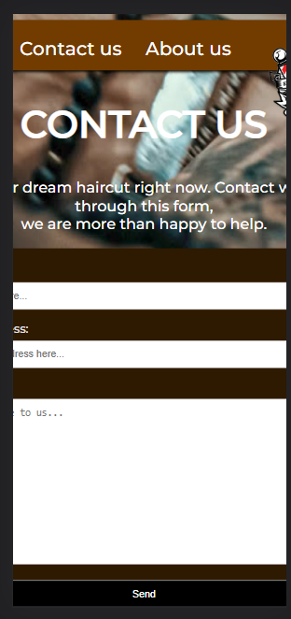
How responsive is our website? We tried to make our website to be more appealing to user with smaller device (390px wide and under). For example: on the iPhone 12 Pro

Slide 7
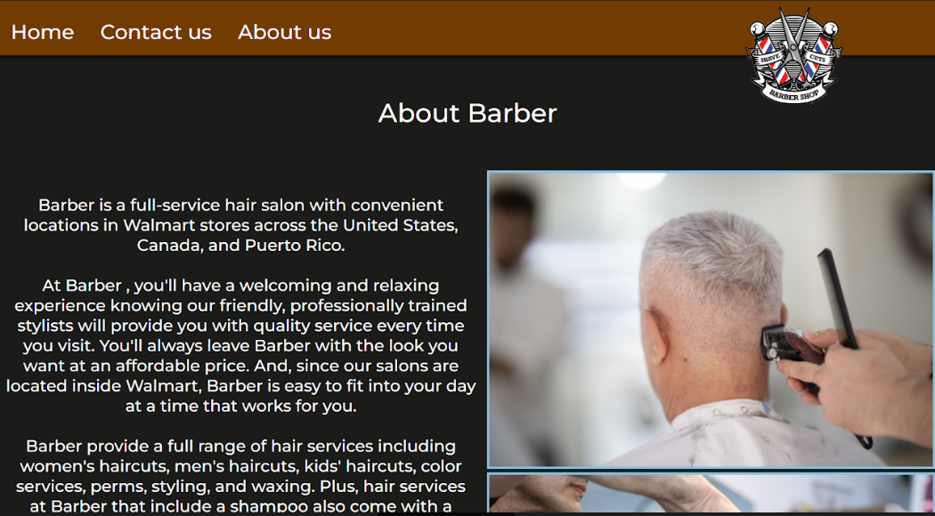
This page is dedicated to introducing our Barber shop. It includes our store's schedule and vision, an introduction to our professional staff, as well as the unique services that only BARBER offers. Additionally, we collaborate with major companies specialized in hair restoration products

Slide 8
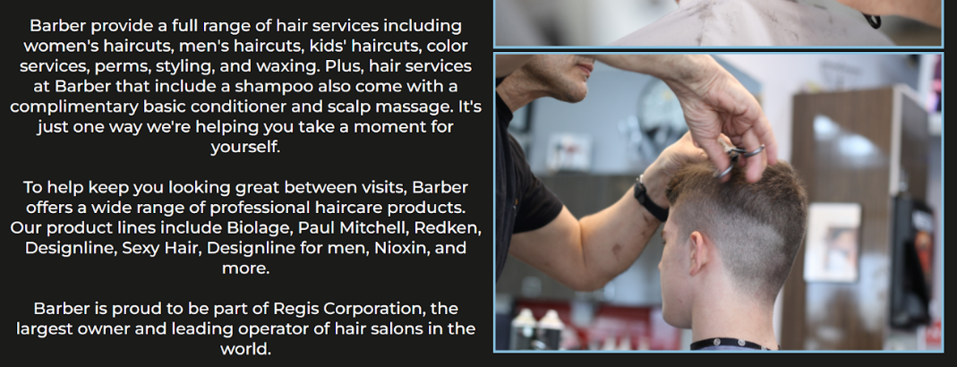
This page is dedicated to introducing our Barber shop. It includes our store's schedule and vision, an introduction to our professional staff, as well as the unique services that only BARBER offers. Additionally, we collaborate with major companies specialized in hair restoration products

Slide 9
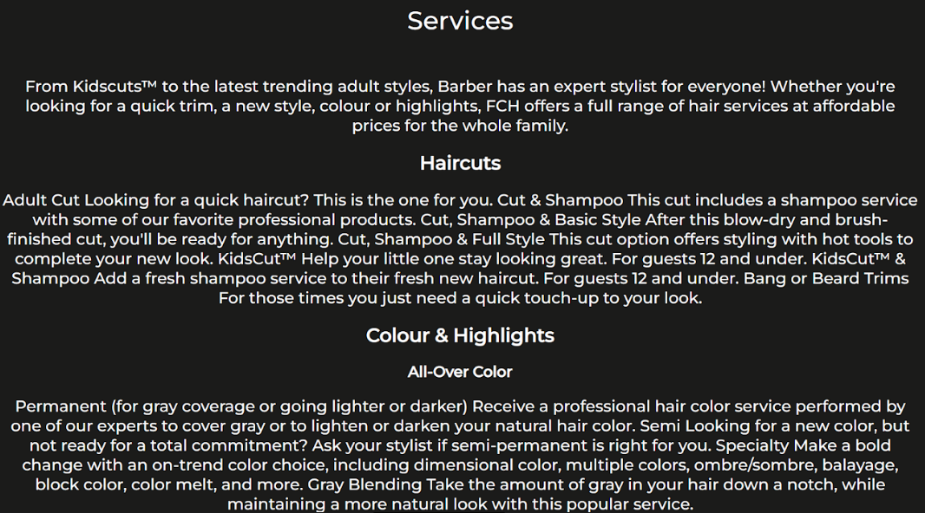
This page is dedicated to introducing our Barber shop. It includes our store's schedule and vision, an introduction to our professional staff, as well as the unique services that only BARBER offers. Additionally, we collaborate with major companies specialized in hair restoration products

Slide 10
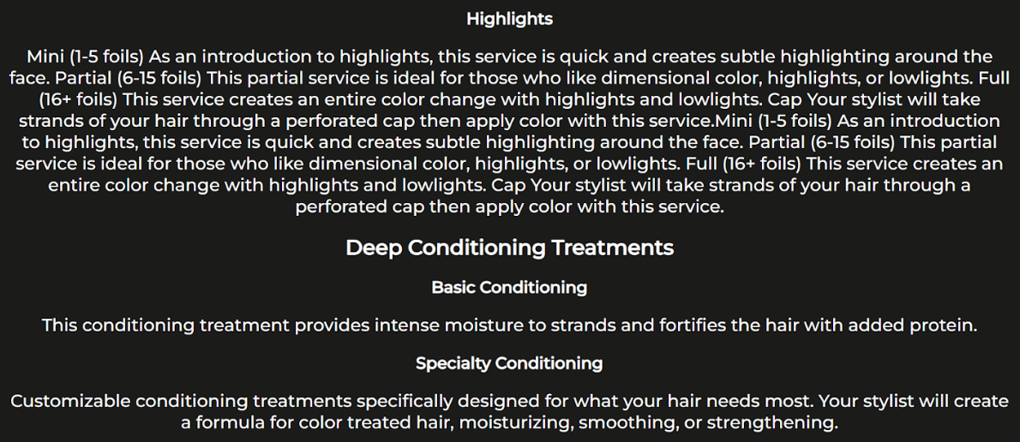
This page is dedicated to introducing our Barber shop. It includes our store's schedule and vision, an introduction to our professional staff, as well as the unique services that only BARBER offers. Additionally, we collaborate with major companies specialized in hair restoration products

Slide 11
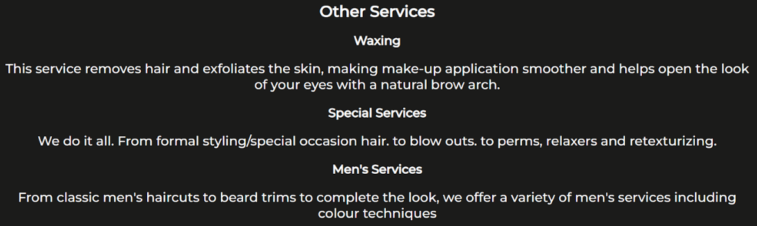
This page is dedicated to introducing our Barber shop. It includes our store's schedule and vision, an introduction to our professional staff, as well as the unique services that only BARBER offers. Additionally, we collaborate with major companies specialized in hair restoration products

Slide 12
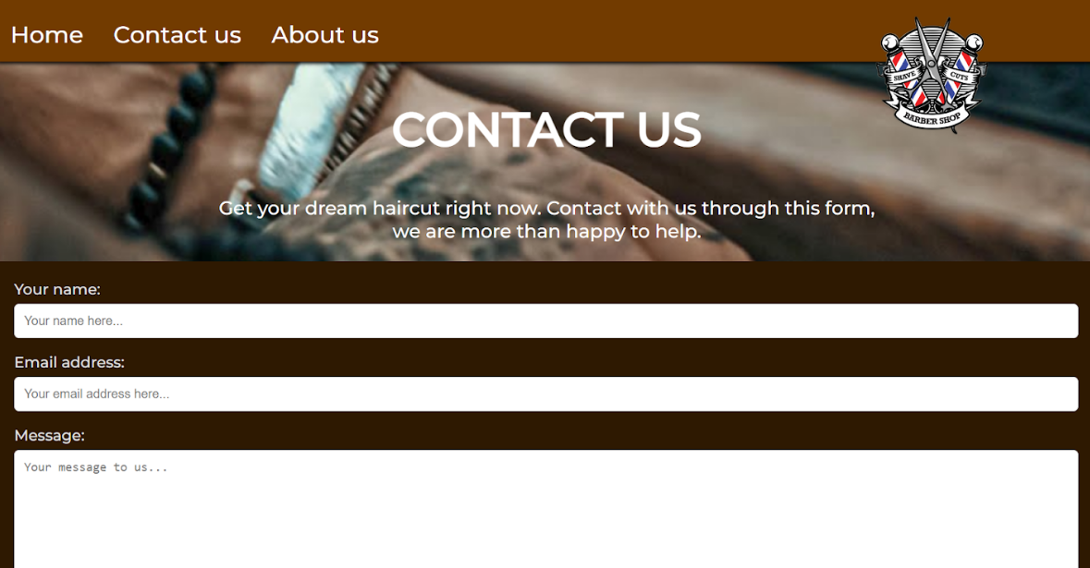
This is the page that helps customers get in touch with us. Here, you can fill in your name, email address, and any questions you may have. We have a dedicated team to answer the questions you send to us.

Slide 13
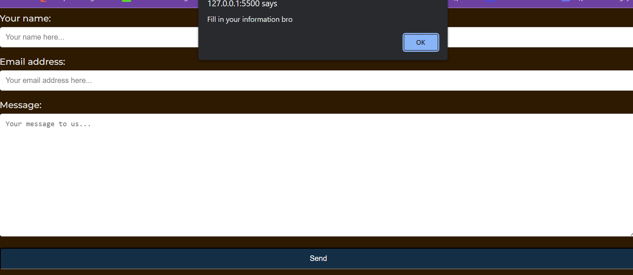
If you accidentally send the form without fill in your information then no worry we will give you a friendly reminder.

Slide 14
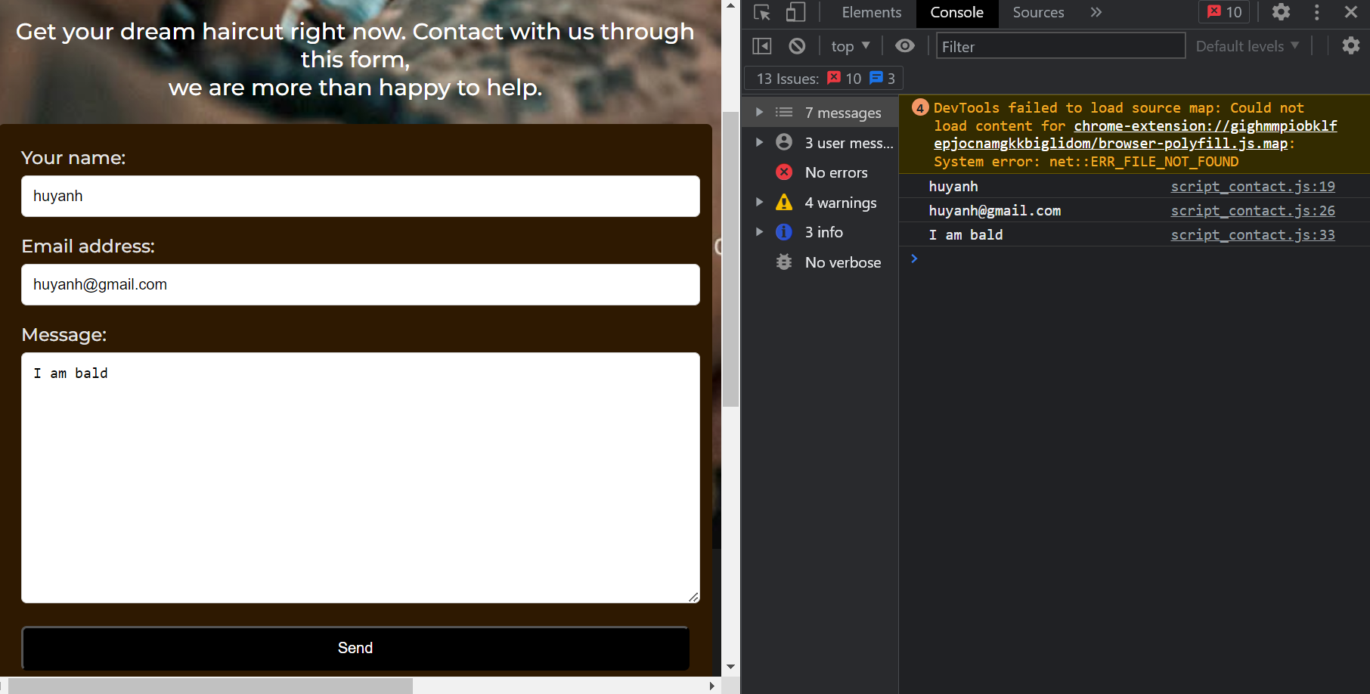
After send the information the client data will be logged into console.

Slide 15
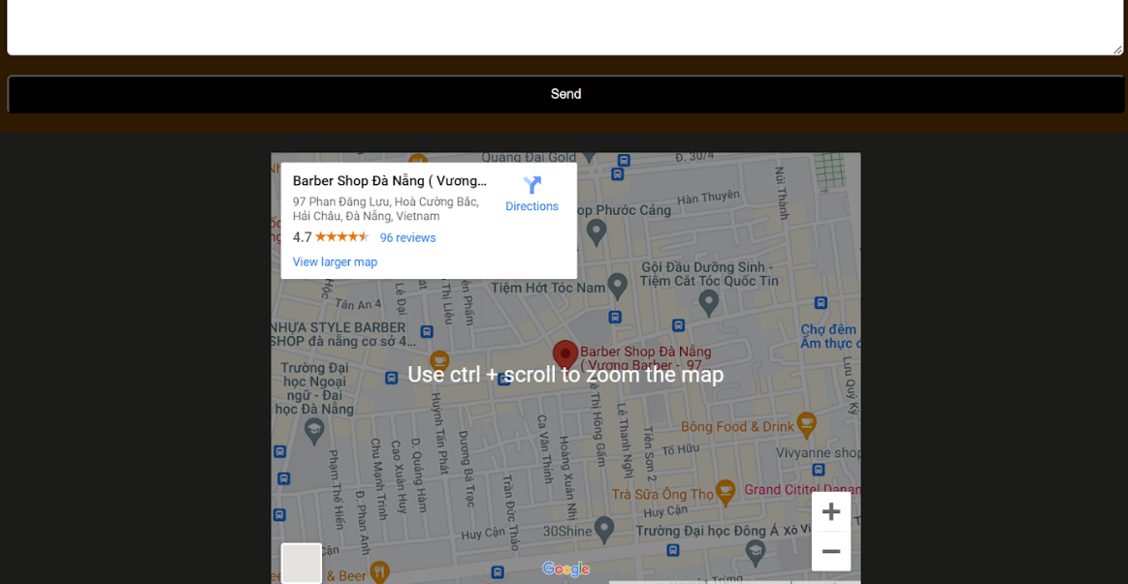
This is the page that helps customers get in touch with us. Here, you can fill in your name, email address, and any questions you may have. We have a dedicated team to answer the questions you send to us.

Slide 16






My idea and the result after I coded it are different.
Working with JavaScript is more difficult compared to HTML and CSS.
The images are moving back and forth.
Encounter difficulties with coding, design, hosting, or other technical aspects of the website.
I have consulted some resources on HTML, CSS, and W3Schools has been very helpful to me throughout this process.

Slide 17





Planning ahead: Before starting to create a website, plan out the content, design, and necessary features. This helps save time and effort during the development process.
Simplicity in design: A simple design makes your website easy to read, search, and optimize loading speed. It also helps reduce errors and increase stability for your website.
Responsive design: Design must be able to adapt to different devices, from desktop computers to mobile phones and tablets. Therefore, make sure your website is designed to fit all types of devices.
SEO optimization: SEO optimization helps your website be easily found on search engines such as Google, Bing, Yahoo, etc. This ensures that your website is seen by more people.
Maintenance and management: Websites need to be regularly maintained and managed to ensure stability and optimal operation.
Continuous updates: Keep updating the content and features of your website regularly to ensure that it is up-to-date and meets the needs of users.
Social media integration: Connecting with social networks such as Facebook, Twitter, Instagram, etc. helps your website reach a wider audience and increases interaction on your website.
User interaction: Website design must ensure user interaction through tools such as chatbots, contact forms, live chat, etc.

Slide 18



